Slide 1
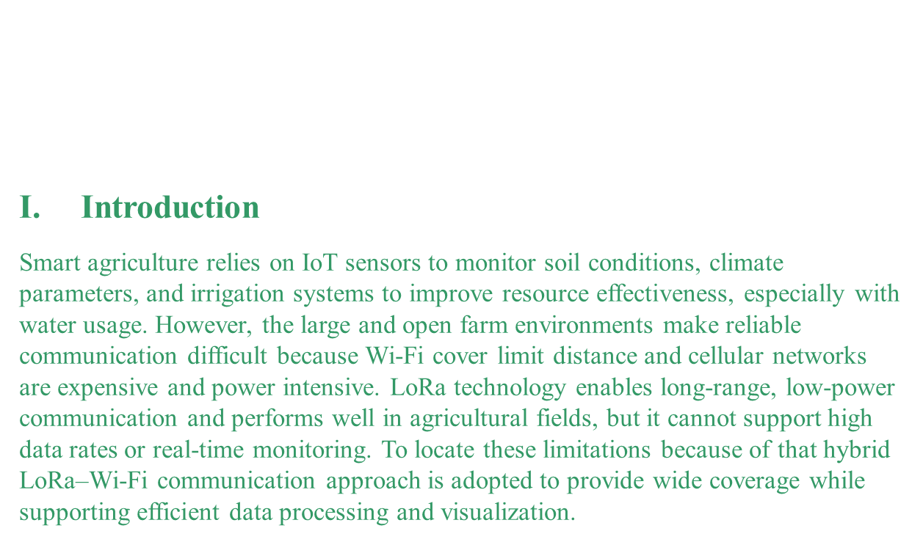
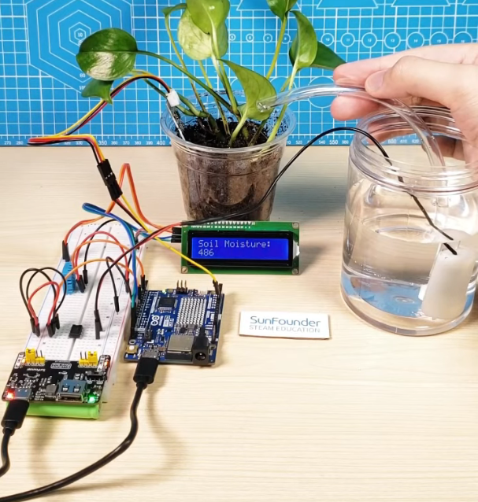
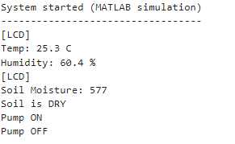
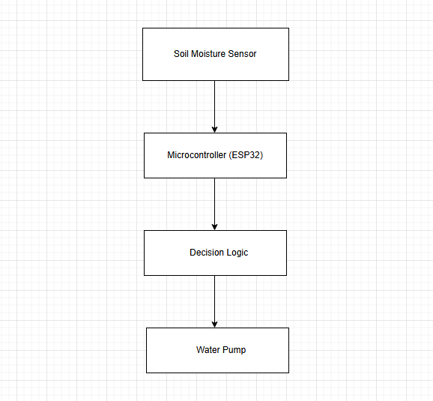

LoRa–Wi-Fi Hybrid IoT Framework for Sustainable
Smart Farms
ID: 223006874
ID: 223040601
ID: 223004840
Authors: Luca Davoil, Gianluigi Ferrari
Internet of Things (IoT) Lab, Department of Engineering and Architecture,University of Parma, Parco Area delle Scienze, 181, 43124 Parma, Italy
Abstract
Smart farming depends on reliable communication between sensors and farm management systems. Many farms cover large space areas where different networks like Wi-Fi have limited coverage spaces, while cellular networks are expensive and not available in all areas. LoRa provides long-range and low-power communication. Also, making it compatible for remote agricultural fields, but only within a short range. This paper presents a hybrid LoRa–Wi-Fi IoT framework designed for sustainable smart farming.
Keywords
LoRa, Wi-Fi, smart farming
IV. Experiments
A soil moisture sensor is inserted into the plant soil to continuously measure moisture levels. The sensor reads the microcontroller, and the measured value was displayed in real time on an LCD screen.
When the soil moisture value drops down to the threshold. Then, the water pump starts automatically to irrigate the plant. Water was delivered directly to the soil through a connected tube until adequate moisture was refilled.
The system operated autonomously without manual intervention, demonstrating a closed-loop control mechanism for smart irrigation.
II. Principle
The proposed research is based on a hybrid IoT communication principle that combines LoRa and Wi-Fi to support compatible smart farming. The system splits communication tasks according to their requirements. LoRa is used for long-range, low-power transmission between distributed sensor nodes and a central gateway, making it convenient for large open agricultural fields. Wi-Fi is used at the gateway level to transfer aggregated data to a local or cloud server, where higher data rates and reliable connectivity are required. This division ensures efficient energy usage, wide coverage, and practical data handling, while maintaining a simple and scalable system architecture suitable for real farm environments.
Fig. 3. Smart Plant Watering System.
III. Theoretical Modelling
V. Results and Analyses
1-Prototype and Simulation Results
A MATLAB simulation was developed to do the same behavior of the Arduino-based smart irrigation system. Temperature, humidity, and soil moisture values were generated dynamically to emulate real sensor readings. The simulated output matches the logic of the physical prototype.
2-Soil Moisture Control
Soil moisture values were monitored continuously and comparing it against a predefined threshold. When the moisture level exceeded the dry threshold (≈450 ADC), the irrigation pump was activated automatically and stopped after a fixed duration. This confirms correct threshold-based decision making.
3-System Behavior
Temperature and humidity values changed gradually, simulating real environmental conditions.
Soil moisture is affecting pump activation.
The system operated without manual intervention.
4-Performance Observation
The results demonstrate reliable sensing, correct control logic, and stable operation. The MATLAB simulation validates the functionality of the proposed smart irrigation system before hardware deployment.
The theoretical model of the proposed system is based on a closed-loop control approach for automatic irrigation.
Soil moisture is considered the primary input variable, which reflects the water content in the soil.
A soil moisture sensor converts the physical soil condition into an electrical signal. This signal is processed by the microcontroller and compared with a predefined moisture threshold.
If the measured moisture value is lower than the threshold, the system generates a control signal to activate the water pump.
The pump remains active until the soil moisture reaches an acceptable level, after which it is automatically turned off. This control logic ensures efficient water usage and prevents over-irrigation. Mathematically, the control decision can be expressed as:
If
Soil Moisture < Threshold → Pump = ON
Soil Moisture ≥ Threshold → Pump = OFF
Fig1 describes the process of how LoRa activated and stored between sensors to the whole irrigation system.
Fig. 4. MATLAB Simulation Result
VI. Conclusion
This work presents a LoRa–Wi-Fi hybrid IoT framework for sustainable smart farming that overcomes the limitations of single-technology solutions. By using LoRa for long-range, low-power field sensing and the system achieves reliable communication, low energy consumption, and good scalability. Experimental results confirm that the proposed framework is suitable for real agricultural environments and supports efficient, long-term farm monitoring.
Fig. 1. Block diagram of the soil moisture–based automatic irrigation system
References
[[2] LoRa Alliance, “LoRaWAN® Network Architecture Overview,” 2023.
https://www.youtube.com/watch?v=U66KAY86dfs&list=LL&index=4
Author email: luca.davoli@unipr.it
2023 IEEE International Conference on LoRa–Wi-Fi Hybrid IoT Framework for Sustainable Smart Farms

